Slide 1
Murach’s Modern JavaScript
Chapter 6
How to script the DOM

Slide 2
Objectives
Applied
Use the querySelector() and querySelectorAll() methods of the document object to get elements from the DOM.
Script elements and their attributes using their properties and methods.
Script form and control elements including text boxes, text areas, select lists, radio buttons, and check boxes.
Preload images.
Knowledge
Describe the use of these properties for working with nodes: parentNode, childNodes, firstChild, lastChild, nextElementSibling, nodeValue, and textContent.
Distinguish between the DOM API and the HTML DOM API.
Describe how DOM scripting can be used for data validation.
Identify what triggers the following events: focus, blur, click, dblclick, change, and select.

Slide 3
The HTML for a web page
<!DOCTYPE html>
<html>
<head>
<title>Join Email List</title>
</head>
<body>
<h1>Please join our email list</h1>
<form id="join_form" action="join.html"
method="post">
<label for="email_address">Email Address:
</label>
<input type="text" id="email_address"
name="email_address">
<span id="email_error">*</span><br>
</form>
</body>
</html>

Slide 4
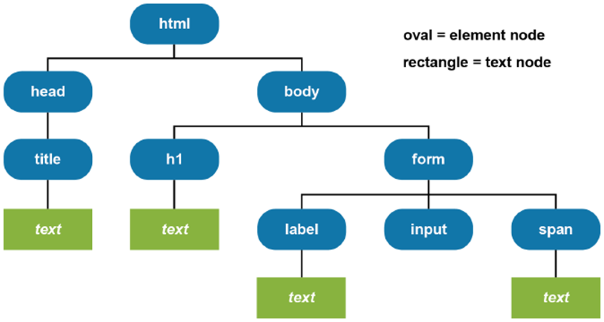
The DOM for the web page

Slide 5
DOM scripting concepts
The DOM (Document Object Model) is a hierarchical collection of nodes in the browser’s memory that represents the current web page.
The browser builds the DOM for a web page as it loads the page.
A node can represent an HTML element, an HTML attribute, or the text for an element or attribute.
A parent node has one or more child nodes.
A sibling node has the same parent as another node.
A descendant node descends from the same node as another node.
JavaScript can modify the web page in the browser by modifying the DOM.

Slide 6
Two methods of the document object and element objects
querySelector(selector)
querySelectorAll(selector)
Get an element by its ID
const textBox = document.querySelector("#email_address");
Get the first <a> element in a document
const firstLink = document.querySelector("a");
Get an array of all <a> elements in a document
const links = document.querySelectorAll("a");

Slide 7
A <ul> element that contains two <li> elements
<ul id="image_list">
<li><img src="images/lion.png"></li>
<li><img src="images/tiger.png"></li>
</ul>
Get an array of all <li> elements within the <ul> element
const list = document.querySelector("#image_list");
const items = list.querySelectorAll("li");
Another way to get the same array
const items =
document.querySelectorAll("#image_list li");

Slide 8
Some properties for working with nodes
parentNode
childNodes
firstChild
lastChild
nextElementSibling
textContent

Slide 9
A <span> element with three child elements
<span><b>Welcome </b><u>Back</u><i>!</i></span>
Get the <span> element
const span = document.querySelector("span");
Get the child elements of the <span> element
const bElem = span.firstChild; // first child
const uElem = span.firstChild.nextElementSibling;
// second child
const iElem = span.lastChild; // third child

Slide 10
Get the text from a child element
console.log(uElem.textContent);
// displays "Back"
Get the all the text in the <span> element
console.log(span.textContent);
// displays "Welcome Back!"
Set the text of the first child element
span.firstChild.textContent = "Hurry ";
console.log(span.textContent);
// displays "Hurry Back!"
Set the text of the <span> element
span.textContent = "Hi";
// replaces all child elements
console.log(span.textContent);
// displays "Hi"

Slide 11
Four methods available from an element
hasAttribute(name)
getAttribute(name)
setAttribute(name, value)
removeAttribute(name)

Slide 12
A list element that has two attributes
<ul id="image_list" class="close">
<li><img src="images/lion.png"></li>
<li><img src="images/tiger.png"></li>
</ul>
Get the element
const list = document.querySelector("#image_list");
Check if the element has an attribute
if (list.hasAttribute("class")) {
console.log("list has class attribute");
}

Slide 13
Get an attribute
const listClass = list.getAttribute("class");
Set an attribute
list.setAttribute("class", "open");
Remove an attribute
list.removeAttribute("class");

Slide 14
Some properties that make it easier to script attributes
Element | Property | Attribute
(all) | id | The id attribute
 | title | The title attribute
 | className | The class attribute. To set multiple class names, separate the names with spaces.
<a> | href | The href attribute
<img> | src | The src attribute
 | alt | The alt attribute
<input> | disabled | The disabled attribute

Slide 15
The HTML for an <a> element
<a href="https://www.murach.com" title="Murach">
Visit our website
</a>
Two ways to get and set the title attribute of an element
const link = document.querySelector("a");
With the DOM API
console.log(link.getAttribute("title"));
// displays "Murach"
link.setAttribute("title", "Amazon");
// sets title to "Amazon"
With the HTML DOM API
console.log(link.title); // displays "Amazon"
link.title = "Murach"; // sets title to "Murach"

Slide 16
Set and get a class attribute with two class names
const div = document.querySelector("div");
div.className = "open plus";
// class attribute is "open plus"
console.log(div.className);
// displays "open plus"
Get and set the href attribute of an <a> element
const link = document.querySelector("a");
console.log(link.href);
// displays "https://murach.com"
link.href = "https://amazon.com";
// sets href to "https://amazon.com"
Get and set the src attribute of an <img> element
const image = document.querySelector("#image");
console.log(image.src); // displays the src attribute
const source =
image.src.replace("lion.png", "tiger.png");
image.src = source; // sets the new src attribute

Slide 17
Disable and enable an <input> element
document.querySelector("#play_button").disabled = true;
document.querySelector("#play_button").disabled = false;

Slide 18
Another property of an element
classList
Common properties of the classList object
length
value
Common methods of the classList object
contains(className)
add(className)
remove(className)
replace(oldName, newName)
toggle(className)

Slide 19
A heading element
<h2 class="first">Welcome to our website!</h2>
Get the heading element
const h2 = document.querySelector("h2");
Add a CSS class
h2.classList.add("blue");
// class attribute is "first blue"
Replace a CSS class
h2.classList.replace("blue", "red");
// attribute is "first red"
Remove a CSS class
h2.classList.remove("red");
// attribute is "first"

Slide 20
Toggle a CSS class
h2.classList.toggle("blue");
// attribute is "first blue"
h2.classList.toggle("blue");
// attribute is "first"
h2.classList.toggle("blue");
// attribute is "first blue"
Check for a CSS class before taking an action
if (h2.classList.contains("blue")) {
h2.classList.add("bold");
// attribute is "first blue bold"
}

Slide 21
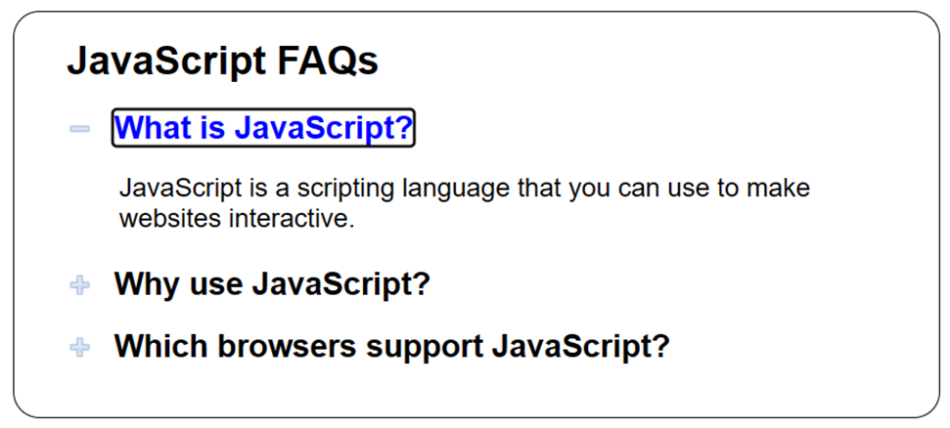
The FAQs app

Slide 22
Some of the HTML for the FAQs app (part 1)
<body id="faqs">
<h1>JavaScript FAQs</h1>
<h2><a href="#">What is JavaScript?</a></h2>
<div>
<p>JavaScript is a scripting language that you
can use to make websites interactive.</p>
</div>
<h2><a href="#">Why use JavaScript?</a></h2>
<div>
<ul>
<li>It has simple syntax that's easy to
learn.</li>
<li>It's versatile.</li>
<li>It's one of the most popular programming
languages.</li>
</ul>
</div>

Slide 23
Some of the HTML for the FAQs app (part 2)
<h2><a href="#">Which browsers support JavaScript?
</a></h2>
<div>
<p>All the major modern browsers support
JavaScript.</p>
</div>
<script src="faqs.js"></script>
</body>

Slide 24
Some of the CSS for the FAQs app
a {
color: black;
text-decoration: none;
}
a:focus, a:hover {
color: blue;
}
h2 {
cursor: pointer;
background: url(images/plus.png) no-repeat left center;
}
h2.minus {
background: url(images/minus.png) no-repeat left center;
}
div {
display: none;
}
div.open {
display: block;
}

Slide 25
The JavaScript for the FAQs app (part 1)
// event handler for the click event of each <h2> element
const toggleVisibility = evt => {
const h2 = evt.currentTarget; // get <h2> element
const div = h2.nextElementSibling; // get <div> element
h2.classList.toggle("minus");
div.classList.toggle("open");
evt.preventDefault(); // cancel default action
// of child <a> element
};

Slide 26
The JavaScript for the FAQs app (part 2)
document.addEventListener("DOMContentLoaded", () => {
// get the <h2> elements
const h2s = document.querySelectorAll("#faqs h2");
// attach event handler for each <h2> element
for (let h2 of h2s) {
h2.addEventListener("click", toggleVisibility);
}
// set focus on first <a> element
h2s[0].firstChild.focus();
});

Slide 27
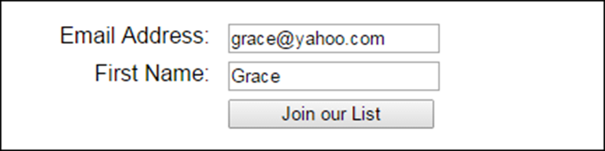
A form in a browser
Attributes of the <form> element
action
method

Slide 28
The HTML for the form
<form action="join.php" method="post">
<label for="email_address">Email Address:</label>
<input type="text" id="email_address"
name="email_address">
<br>
<label for="first_name">First Name:</label>
<input type="text" id="first_name" name="first_name">
<br>
<label>&nbsp;</label>
<input type="submit" value="Join our List">
</form>

Slide 29
Two properties available from most controls
name
value
HTML for a text box, text area, and select list
<label for="name">First Name:</label>
<input type="text" name="name" id="name"><br>
<label for="comment">Comment:</label>
<textarea name="comment" id="comment" rows="5" cols="40"></textarea><br>
<label for="country">Country:</label>
<select name="country" id="country">
<option value="">Select a country...</option>
<option value="usa">USA</option>
<option value="can">Canada</option>
<option value="mex">Mexico</option>
</select><br>

Slide 30
JavaScript to get the text box, text area, and select list values
const name = document.querySelector("#name").value;
const comment = document.querySelector("#comment").value;
const country = document.querySelector("#country").value;
if (country == "usa") {
alert("You selected USA.");
} else if (country == "can") {
alert("You selected Canada.");
} else if (country == "mex") {
alert("You selected Mexico.");
} else {
alert("Please select a country.");
}

Slide 31
JavaScript to set the text box, text area, and select list values
document.querySelector("#country").value = "";
document.querySelector("#name").value = "";
document.querySelector("#comment").value = "";

Slide 32
A property of radio buttons and check boxes
checked
HTML for two radio buttons and a check box
<label>Contact me by:</label>
<input type="radio" name="contact" id="text" value="text"
checked>Text
<input type="radio" name="contact" id="email" value="email">Email<br>
<label>Terms of Service:</label>
<input type="checkbox" name="accept" id="accept">
I accept<br>

Slide 33
JavaScript to get the radio button and check box values
if (document.querySelector("#text").checked) {
/*text processing*/
} else if (document.querySelector("#email").checked) {
/*email processing*/
}
if (document.querySelector("accept").checked) {
/*accept processing*/
} else {
alert("You must accept our terms of service.");
}
JavaScript to set the radio button and check box values
document.querySelector("#text").checked = false;
document.querySelector("#email").checked = false;
document.querySelector("#accept").checked = true;

Slide 34
Two methods commonly used with forms
submit()
reset()
Three methods commonly used with controls
focus()
blur()
select()

Slide 35
Common control events
click
dblclick
focus
blur
change
select

Slide 36
A custom function used by the following examples
const getElement = selector =>
document.querySelector(selector);
Submit a form
getElement("#registration_form").submit();

Slide 37
An event handler that attaches two other event handlers
document.addEventListener("DOMContentLoaded", () => {
getElement("#investment").addEventListener("change", () => {
calculateClick(); // perform calculation
getElement("#investment").blur(); // remove focus
};
getElement("#years").addEventListener("dblclick", => {
getElement("#years").value = ""; // clear text box
};
getElement("#years").focus();
};

Slide 38
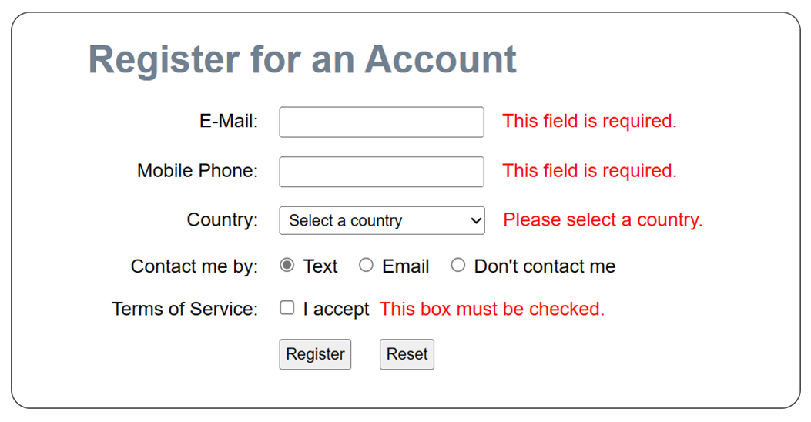
The Register app

Slide 39
The HTML for the form and controls (part 1)
<h1>Register for an Account</h1>
<form action="confirm.html" method="post">
<div>
<label for="email_address">E-Mail:</label>
<input type="text" name="email_address"
id="email_address">
<span>*</span></div>
<div>
<label for="phone">Mobile Phone:</label>
<input type="text" name="phone" id="phone">
<span>*</span></div>
<div>
<label for="country">Country:</label>
<select name="country" id="country">
<option value="">Select a country</option>
<option value="usa">USA</option>
<option value="can">Canada</option>
<option value="mex">Mexico</option></select>
<span>*</span></div>

Slide 40
The HTML for the form and controls (part 2)
<div>
<label>Contact me by:</label>
<input type="radio" name="contact" id="text"
value="text" checked>Text
<input type="radio" name="contact" id="email"
value="email">Email
<input type="radio" name="contact" id="none"
value="none">Don't contact me</div>
<div>
<label>Terms of Service:</label>
<input type="checkbox" name="terms" id="terms"
value="yes">I accept
<label>&nbsp;</label><span>*</span></div>
<div>
<label>&nbsp;</label>
<input type="button" id="register"
value="Register">
<input type="button" id="reset_form"
value="Reset"></div>
</form>

Slide 41
The JavaScript for the Register app (part 1)
const getElement = selector =>
document.querySelector(selector);
const processEntries = () => {
const email = getElement("#email_address");
const phone = getElement("#phone");
const country = getElement("#country");
const terms = getElement("#terms");
let isValid = true;
if (email.value == "") {
email.nextElementSibling.textContent =
"This field is required.";
isValid = false;
} else {
email.nextElementSibling.textContent = "";
}
if (phone.value == "") {
phone.nextElementSibling.textContent =
"This field is required.";
isValid = false;
} else {
phone.nextElementSibling.textContent = "";
}

Slide 42
The JavaScript for the Register app (part 2)
if (country.value == "") {
country.nextElementSibling.textContent =
"Please select a country.";
isValid = false;
} else {
country.nextElementSibling.textContent = "";
}
if (!terms.checked) {
terms.nextElementSibling.textContent =
"This box must be checked.";
isValid = false;
} else {
terms.nextElementSibling.textContent = "";
}
if (isValid) {
getElement("form").submit();
}
};

Slide 43
The JavaScript for the Register app (part 3)
const resetForm = () => {
getElement("form").reset();
getElement("#email_address").nextElementSibling.textContent = "*";
getElement("#phone").nextElementSibling.textContent = "*";
getElement("#country").nextElementSibling.textContent = "*";
getElement("#terms").nextElementSibling.textContent = "*";
getElement("#email_address").focus();
};
document.addEventListener("DOMContentLoaded", () => {
getElement("#register").addEventListener("click",
processEntries);
getElement("#reset_form").addEventListener("click", resetForm);
getElement("#email_address").focus();
});

Slide 44
Two more methods of the document object
createElement(element)
createTextNode(value)
Five methods for adding, replacing, and removing nodes
appendChild(node)
insertBefore(new, child)
replaceChild(new, child)
removeChild(node)
remove()

Slide 45
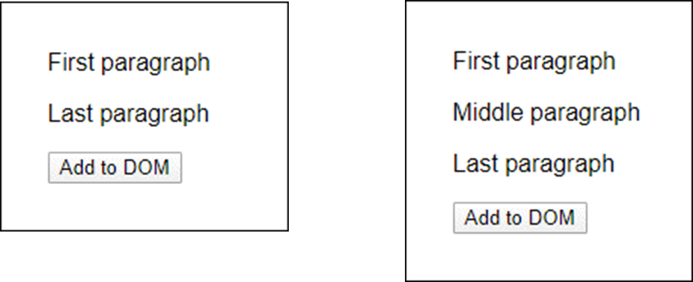
A button that that adds a new <p> element to the DOM
Before button is clicked After button is clicked
The HTML
<p>First paragraph</p>
<p>Last paragraph</p>
<input type="button" id="add" value="Add to DOM">

Slide 46
The click event handler for the button
document.querySelector("#add").addEventListener("click", () => {
// create a new <p> element
const newParagraph = document.createElement("p");
// create a new text node and add it to the new <p> element
const text = document.createTextNode("Middle paragraph");
newParagraph.appendChild(text);
// get the first <p> element in the document and its parent
const firstParagraph = document.querySelector("p");
const parent = firstParagraph.parentNode;
// insert the new <p> element after the first <p> element (that
// is, before the element that comes after the first <p> element)
parent.insertBefore(newParagraph,
firstParagraph.nextElementSibling);
});

Slide 47
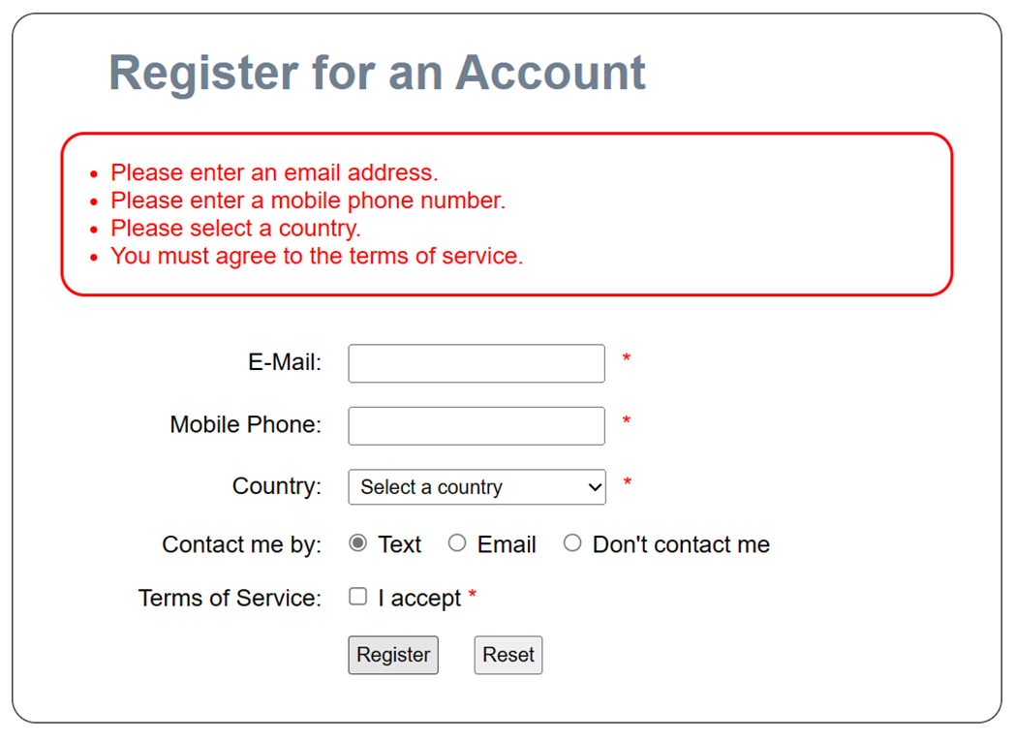
The updated Register app

Slide 48
The CSS for the error messages
.messages {
color: red;
padding: 1em 2em;
margin-bottom: 2em;
border: 2px solid red;
border-radius: 1em;
}

Slide 49
The updated JavaScript (part 1)
const displayErrorMsgs = msgs => {
// create a new ul
const ul = document.createElement("ul");
ul.classList.add("messages");
for (let msg of msgs) { // for each message...
// create li
const li = document.createElement("li");
// create text node
const text = document.createTextNode(msg);
// add text to li
li.appendChild(text);
// add li to new ul
ul.appendChild(li);
}

Slide 50
The updated JavaScript (part 2)
// get ul from form
const node = getElement("ul");
if (node == null) { // if it doesn't exist...
const form = getElement("form");
// add new ul before form
form.parentNode.insertBefore(ul, form);
} else {
// otherwise, replace it
node.parentNode.replaceChild(ul, node);
}
};
const processEntries = () => {
// get form controls to check for validity
const email = getElement("#email_address");
const phone = getElement("#phone");
const country = getElement("#country");
const terms = getElement("#terms");

Slide 51
The updated JavaScript (part 3)
// create array for error messages
const msgs = [];
// check user entries for validity
if (email.value === "") {
msgs.push("Please enter an email address.");
}
if (phone.value === "") {
msgs.push("Please enter a mobile phone number.");
}
if (country.value === "") {
msgs.push("Please select a country.");
}
if (!terms.checked) {
msgs.push("You must agree to the terms of service.");
}

Slide 52
The updated JavaScript (part 4)
// submit the form or notify user of errors
if (msgs.length === 0) { // no error messages
getElement("form").submit();
} else {
displayErrorMsgs(msgs);
}
};
const resetForm = () => {
// no longer need to clear span elements
getElement("form").reset();
// remove error messages if any
const ul = getElement("ul");
if (ul !== null) ul.remove();
getElement("#email_address").focus();
};

Slide 53
The updated JavaScript (part 5)
document.addEventListener("DOMContentLoaded", () => {
getElement("#register").addEventListener("click",
processEntries);
getElement("#reset_form").addEventListener("click",
resetForm);
getElement("#email_address").focus();
});

Slide 54
Four attributes of the <img> element
src
alt
width
height
Create an object that represents an <img> element
const image = new Image();
Preload an image
const image = new Image();
image.src = "image_name.jpg";

Slide 55
Preload all images referenced by the <a> elements in a document
const links = document.querySelectorAll("a");
for (let link of links) {
const image = new Image();
image.src = link.href;
}

Slide 56
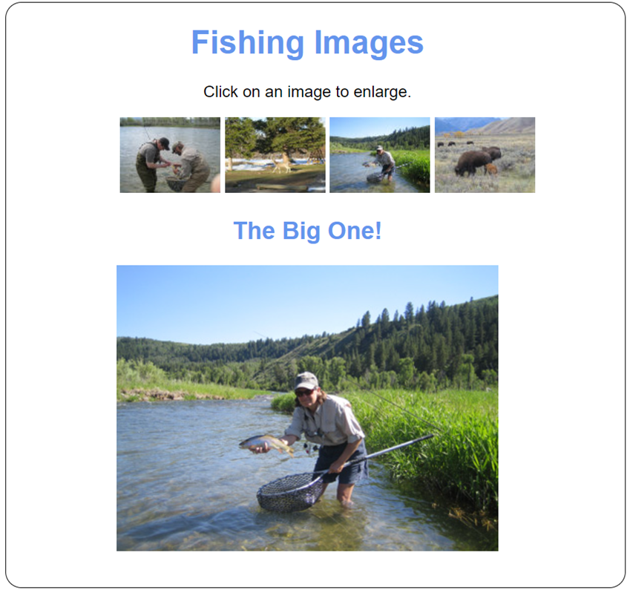
The Image Swap app

Slide 57
The HTML for the <body> element
<body>
<h1>Fishing Images</h1>
<p>Click on an image to enlarge.</p>
<ul id="image_list">
<li><a href="images/release.jpg" title="Catch and Release">
<img src="thumbnails/release.jpg"
alt="release fish"></a></li>
<li><a href="images/deer.jpg" title="Deer at Play">
<img src="thumbnails/deer.jpg" alt="deer"></a></li>
<li><a href="images/hero.jpg" title="The Big One!">
<img src="thumbnails/hero.jpg" alt="big fish"></a></li>
<li><a href="images/bison.jpg" title="Roaming Bison">
<img src="thumbnails/bison.jpg" alt="bison"></a></li>
</ul>
<h2 id="caption">Catch and Release</h2>
<p><img id="main_image" src="images/release.jpg"
alt="Catch and Release"></p>
</body>

Slide 58
The CSS for the <li> elements
li {
display: inline;
}

Slide 59
The JavaScript for the Image Swap app (part 1)
const getElement = selector =>
document.querySelector(selector);
document.addEventListener("DOMContentLoaded", () => {
// get the main image and caption elements
const mainImage = getElement("#main_image");
const caption = getElement("#caption");
// get all the <a> elements in the <ul> element
const imageLinks =
document.querySelectorAll("#image_list a");
// process image links
for (let link of imageLinks) {
// preload image
const image = new Image();
image.src = link.href;

Slide 60
The JavaScript for the Image Swap app (part 2)
// attach event handler for click event
// of <a> element
link.addEventListener("click", evt => {
mainImage.src = link.href;
mainImage.alt = link.title;
caption.textContent = link.title;
// cancel the default action of the link
evt.preventDefault();
});
}
// set focus on first image link
imageLinks[0].focus();
});

